Slide 1

Hospital Management
System
Microservices-Based Architecture with Docker Containerization
Batch 4:
Akash
Ashutosh
Elzabeth Lalson
Dhannigasree
Vignesh

Slide 2
Table of Contents

Slide 3
Problem Statement
Traditional hospital systems are monolithic and tightly coupled
Difficult to scale, maintain, and update individual modules
Lack of deployment flexibility and service isolation

Slide 4
Project Objective
To design and implement a containerized microservices-based Hospital Management System where each core functionality (users, patients, doctors, vitals, registration, admin) runs as an independent service, enabling scalability, isolation, maintainability, and simplified deployment using Docker.

Slide 5
Architecture Diagram

Slide 6
Microservices
Independent services
Single responsibility design
API-based communication
Scalable & maintainable
Docker containerized

Slide 7
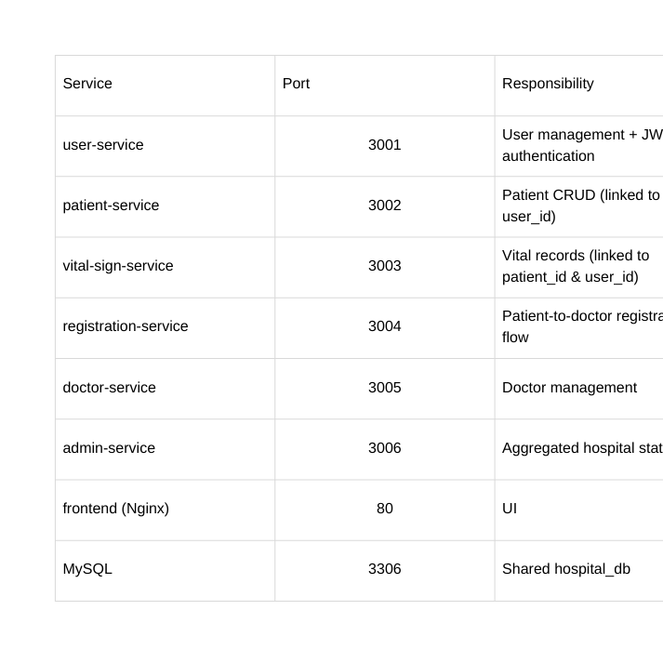
Services

Slide 8
Start with reg or admin microservice

Slide 9
Patient Microservice
Hospital Management System
Port 3002
Handles Patient CRUD operations
Stores and manages patient records
References user_id from user-service
Provides patient_id for other services
Central data layer for patient information
Independently deployable microservice
Dockerized for container-based deployment

Slide 10
Dockerfile Snippet
FROM node:18-alpine
WORKDIR /app
RUN apk add --no-cache netcat-openbsd
COPY package.json ./
RUN npm install --production
COPY . .
EXPOSE 3002
CMD sh -c 'while ! nc -z mysql 3306; do sleep 1; done; node app.js'

Slide 11
docker-compose.yml
patient-service:
build: ./services/patient-service
container_name: hospital-patient-service
restart: always
environment:
DB_HOST: mysql
DB_USER: root
DB_PASSWORD: ${MYSQL_ROOT_PASSWORD:-root123}
DB_NAME: ${MYSQL_DATABASE:-hospital_db}
JWT_SECRET: ${JWT_SECRET:-hospital_management_secret_key_2024}
depends_on:
mysql:
condition: service_healthy
networks:
- hospital-network

Slide 12
screenshots

